Slide 1
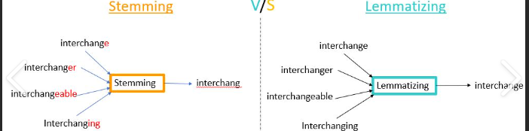
Text Preprocessing
Text preprocessing is an essential step in natural language processing (NLP) that involves cleaning and transforming unstructured text data to prepare it for analysis. It includes tokenization, stemming, lemmatization, stop-word removal, and part-of-speech tagging.
1. Tokenization: process of breaking down a text into individual words or tokens.
Example: “Natural Language Processing is amazing!”
Tokenization Result: [“Natural”, “Language”, “Processing”, “is”, “amazing”, “!”]
2. Stop Words: common words (e.g., “the,” “is,” “and”) that don’t carry significant meaning.
Example:: “The quick brown fox jumps over the lazy dog.”
After Removing Stop Words: [“quick”, “brown”, “fox”, “jumps”, “lazy”, “dog.”]
3. Stemming: reducing words to their root or base form by removing prefixes or suffixes. When you want simplicity and speed, and non-valid words are acceptable.
Over-stemming: where a much larger part of a word is chopped off than what is required, which in turn leads to words being reduced to the same root word incorrectly. Eg: “university” and “universe” that get reduced to “univers”.
Under-stemming: occurs when two or more words could be wrongly reduced to more than one root word when they actually should be reduced to the same root word. Eg: “data” and “datum” that get reduced to “dat” and “datu” instead of “dat”.
4. Lemmatization: involves reducing words to their base or dictionary form to ensure a valid word. When maintaining word validity and understanding context is critical.
Example: “Better, best, good.”
Lemmatization Result: [“good”, “good”, “good”]
am, are, is → be, car, cars, car's, cars' → car
the boy's cars are different colors → the boy car be different color

Slide 2
Issues in Tokenization
what’re, I’m, isn’t → What are, I am, is not
state-of-the-art → state of the art ?
San Francisco → one token or two?
m.p.h., PhD. → ??
While most periods are end of sentence punctuation marks, others mark an abbreviation such as in etc.
Hyphenation-Four kinds of hyphens (Different forms representing the same word)
Tokenization: language issues: Chinese and Japanese no spaces between words; multiple alphabets intermingled; Dates/amounts in multiple formats
Special Characters and Punctuation: Properly tokenizing text with special characters, punctuation, or emojis can be challenging.
Out-of-Vocabulary (OOV) Words: These are words not present in the model’s training data, which can lead to errors in tokenization and subsequent NLP tasks.

Slide 3
Text Normalization
Text normalization in NLP refers to the process of transforming text data into a standardized and consistent format.
Lowercasing: Converting all characters to lowercase.
Removing punctuation: Stripping out punctuation marks.
Expanding contractions: Converting “don’t” to “do not”. Create a dictionary of contractions with their corresponding expansions.
Standardizing spelling: Ensuring consistent spelling (e.g., “color” vs. “colour”).
Normalizing in this context means that similar words are combined into a single, normalized form.
Normalization is helpful in reducing the number of unique tokens present in the text, removing the variations in a text and also cleaning the text by removing redundant information

Slide 4
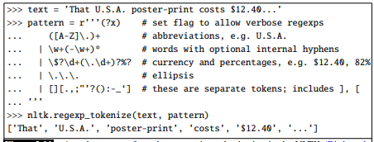
Text Normalization – Regex based Tokenizer
Text Normalization – Levenshtein Min edit
weighting factor in which each of the three operations has a cost of 1
we assume that the substitution of a letter for itself, for example, t for t, has zero cost.
Text Normalization – The Viterbi algorithm
is a probabilistic extension of minimum edit distance.
Instead of computing the “minimum edit distance” between two strings, Viterbi computes the “maximum probability alignment” of one string with another.

Slide 5
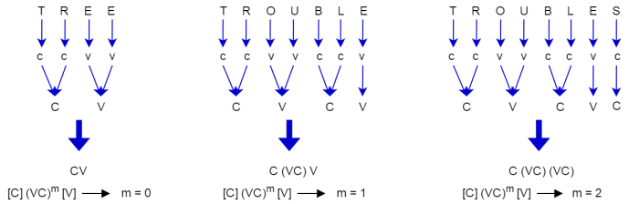
The value m found in the above expression is called the measure of any word or word part when represented in the form [C](VC)m[V].
Measure
M=0 M=1 M=2
Example
TR (CC),EE (VV),TREE (CCVV),Y (C),BY (CC)
TROUBLE (CCVVCCV),TREES(CCVVC)
TROUBLES (CCVVCCVC),PRIVATE (CCVCVCV)

Slide 6
Conditions on the stem
2.*<X> ---the stem ends with a given letter X 3.*v*---the stem contains a vowel
*d ---the stem ends in double consonant
*o ---the stem ends with a consonant-vowel-consonant, sequence, where the final consonant is not w, x or y
*s --- the stem ends with a given letter S

Slide 7
Porter Stemmer Algorithm
-s
Step 1
Plurals and Third Person Singular Verbs
-ed, -ing
fly/flies
Step 2
Verbal Past Tense and Progressive
Step 3: Y to I
Noun Inflections
Steps 4
Derivational Morphology
Multiple Suffixes
Step 5
Cleanup

Slide 8
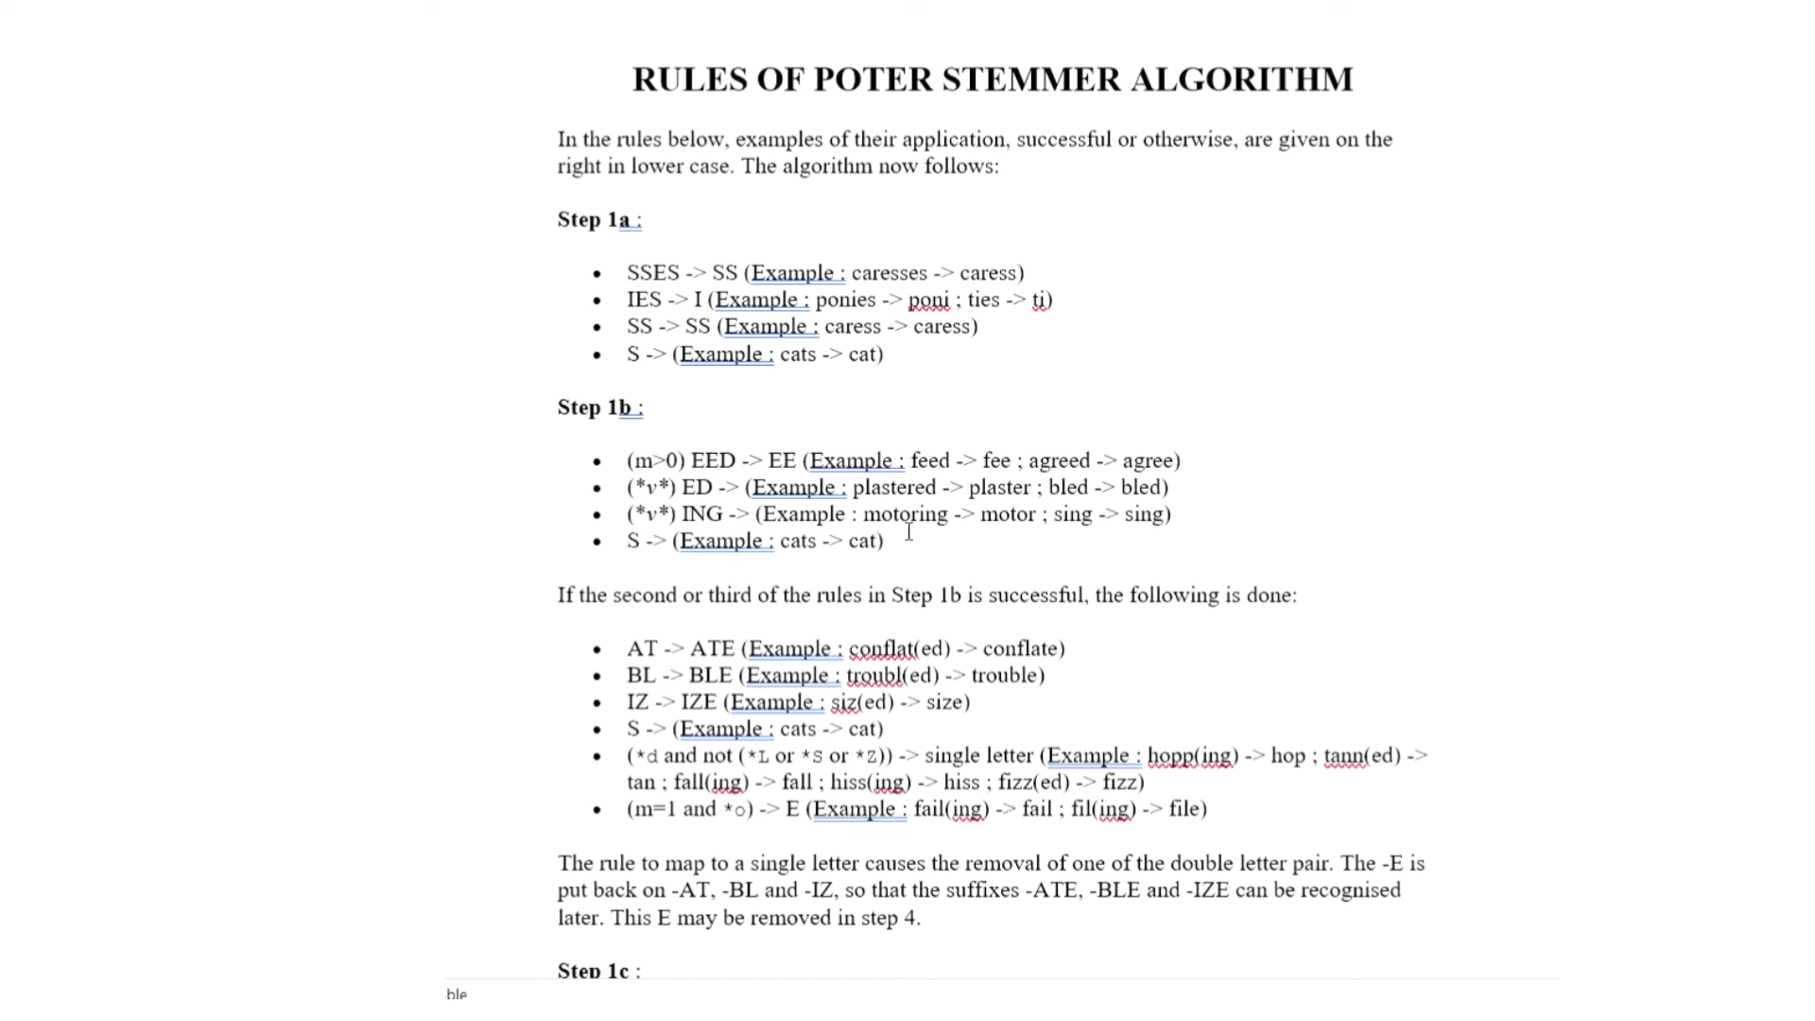
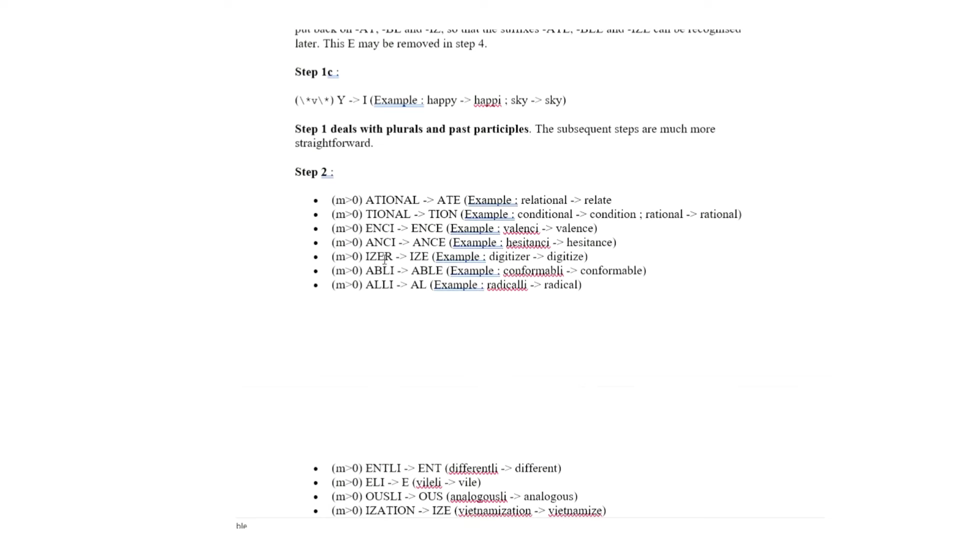
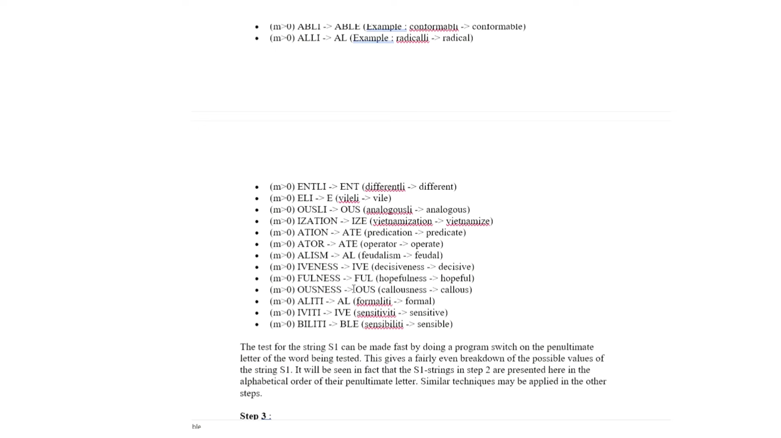

Slide 9
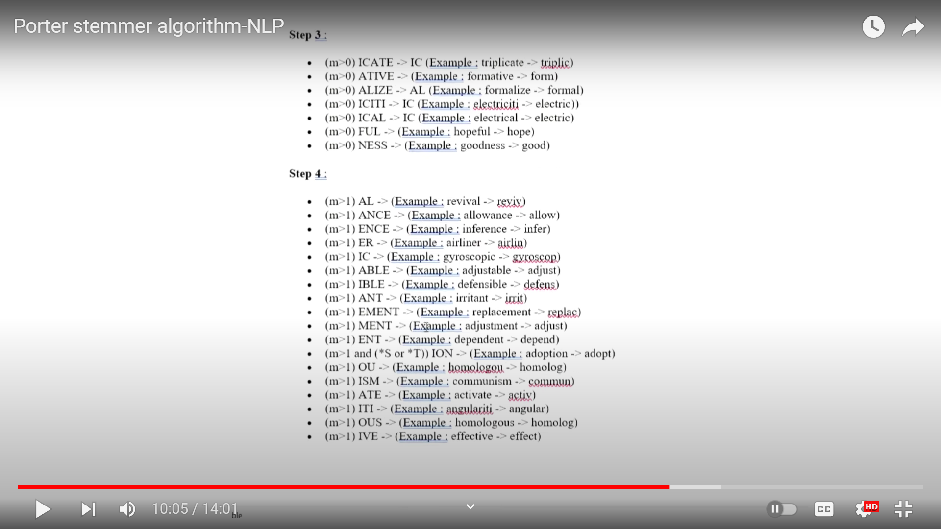
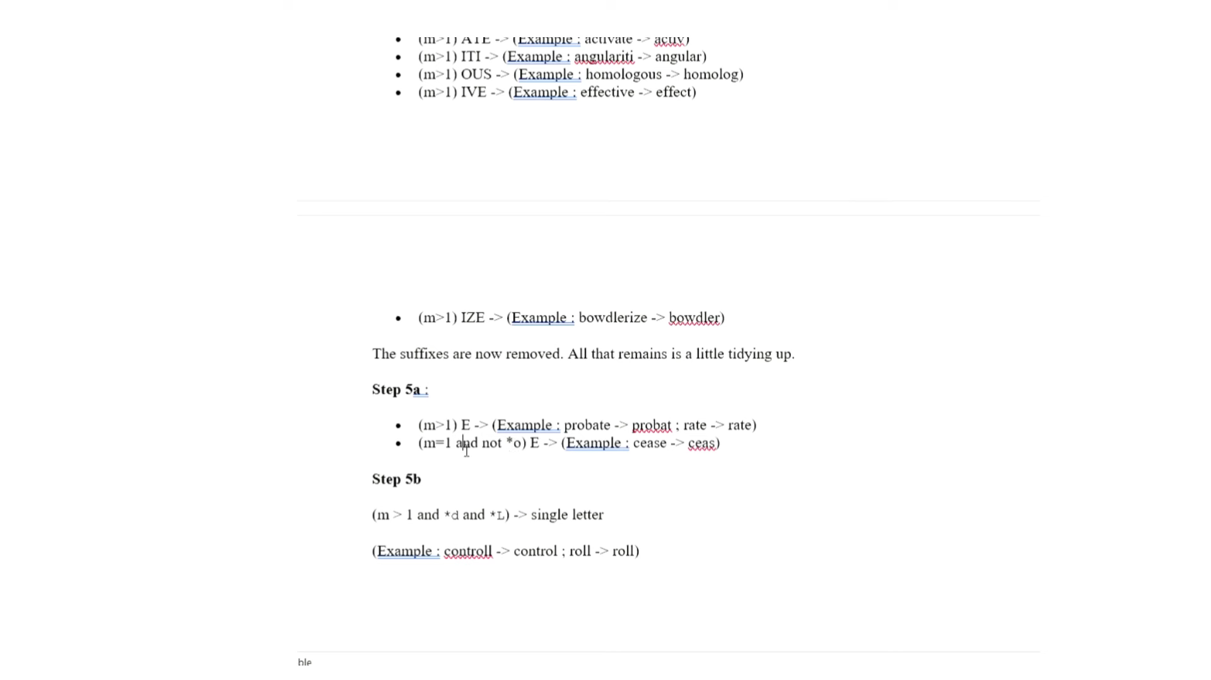

Slide 10
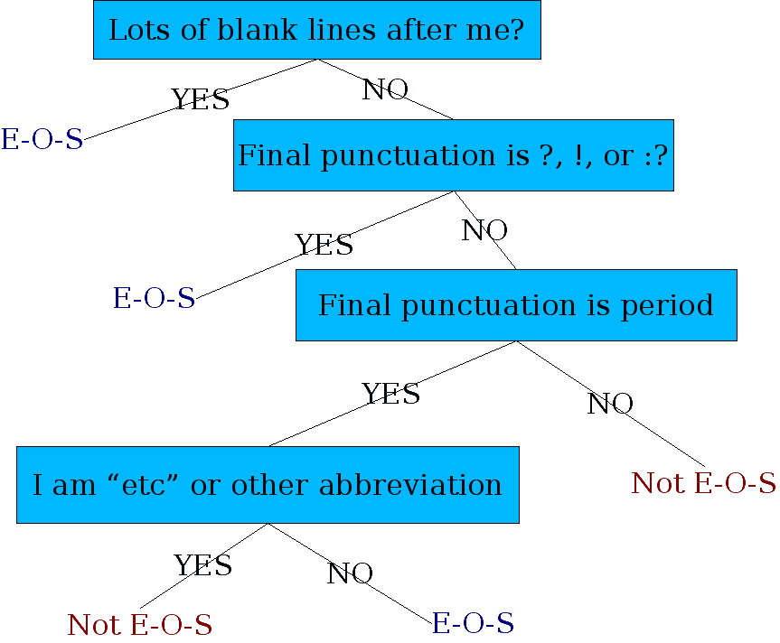
Sentence Segmentation Determining if a word is end-of-sentence: a Decision Tree
While ! And ? Are unambiguous, . Is ambiguous and can be used for end of sentence, for abbreviations (Dr., Mr., Phd.) or for numbers (2.4%, 4.3).

Slide 11
Morphology
Two Types:
Inflectional
Derivational
Inflectional morphology:
It is the combination of a word stem with a grammatical morpheme which results in a word of the same class as the original stem.
cat: cats,
mouse: mice
walk: walking

Slide 12
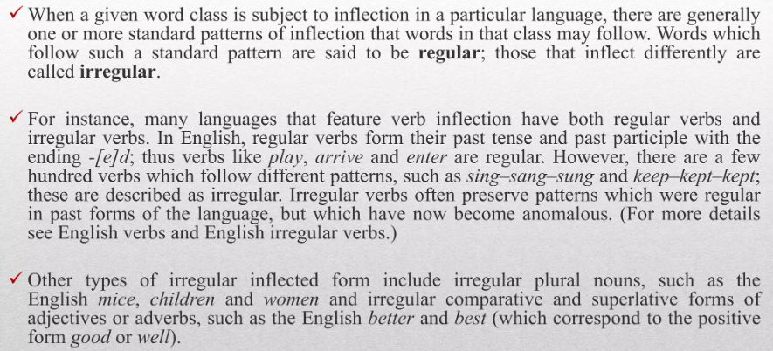
Inflectional Morphology Regular and irregular inflection

Slide 13
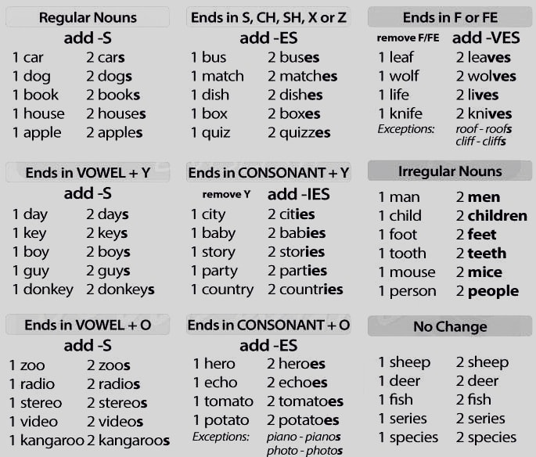
REGULAR PLURALS

Slide 14
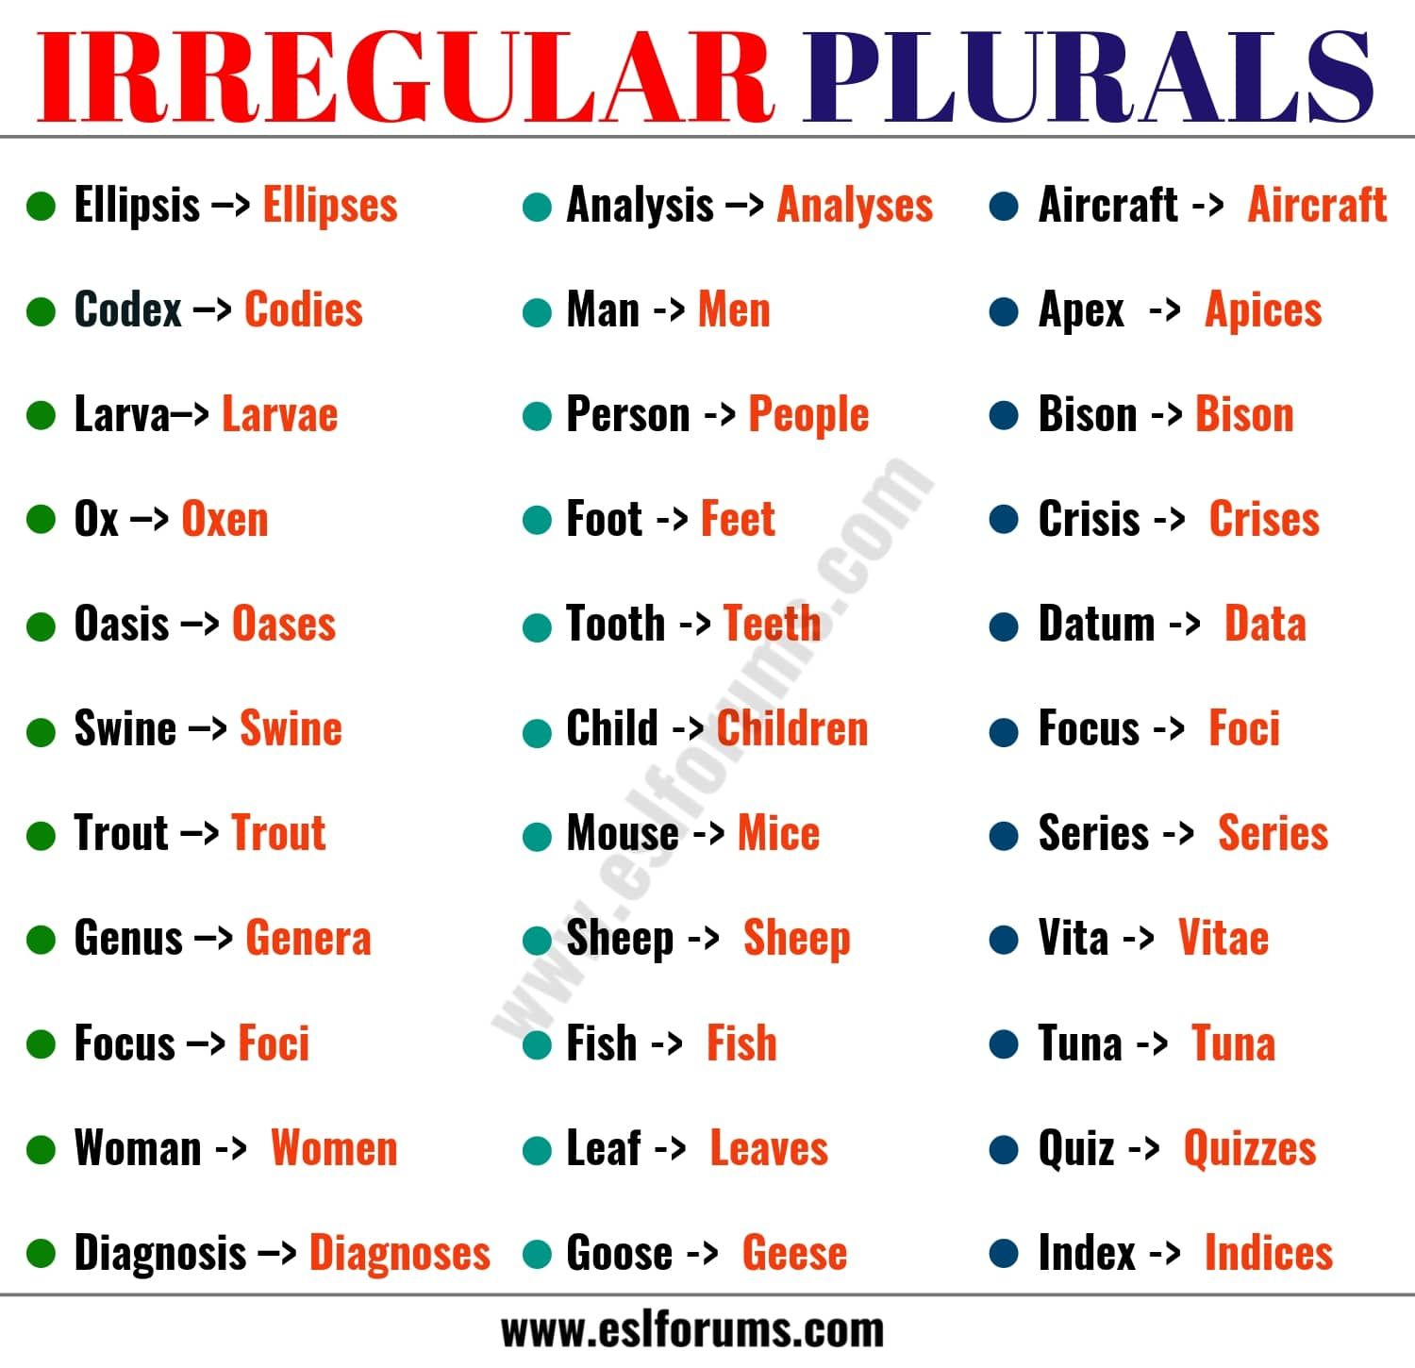
Morphology

Slide 15
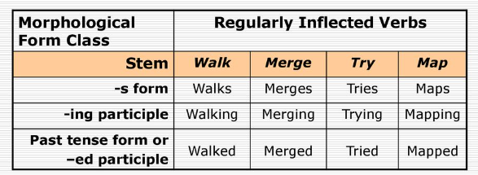
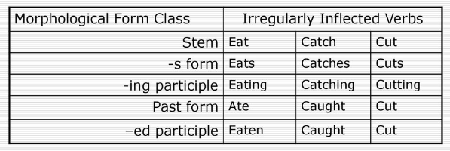



Verb Inflection

Slide 16
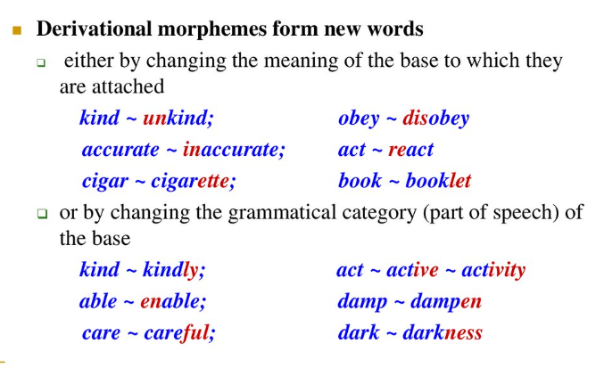
Verb Inflection

Slide 17
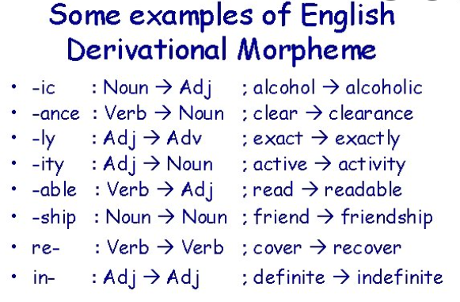

Slide 18
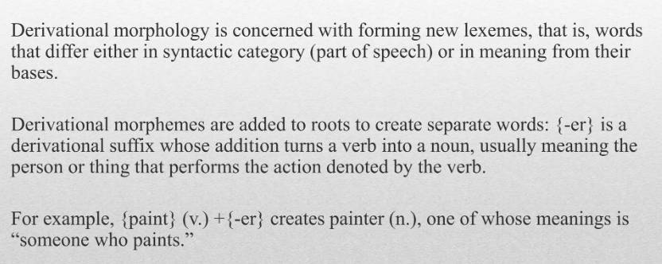
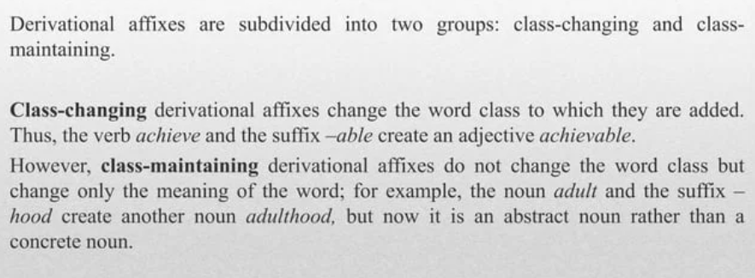
Derivation Morphology
Eg- Paint (Verb) -> Painter(Noun)

Slide 19
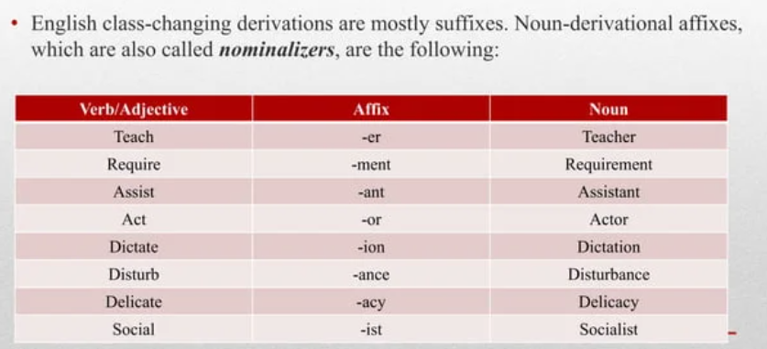
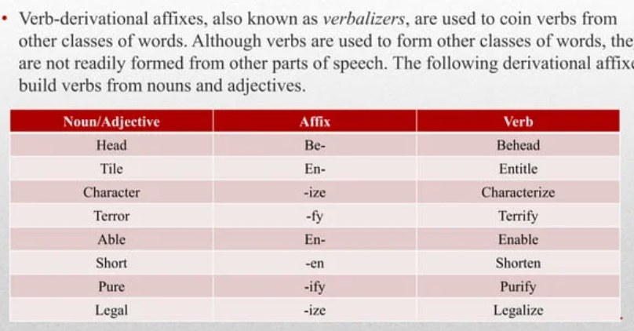
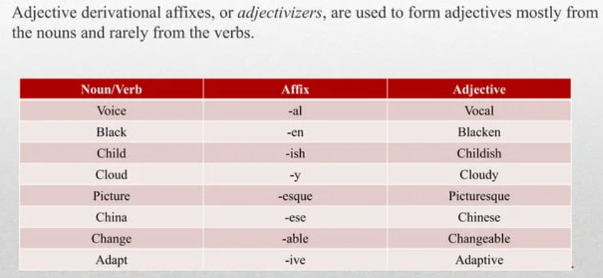
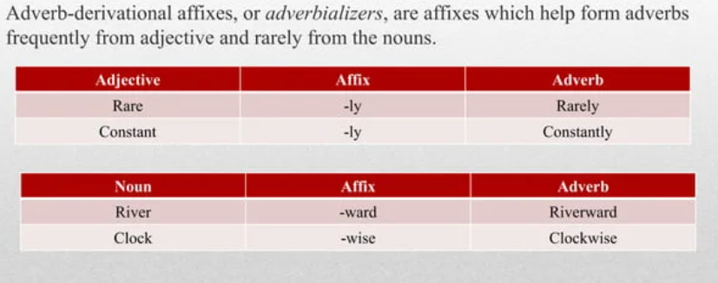
Class-changing affixes

Slide 20
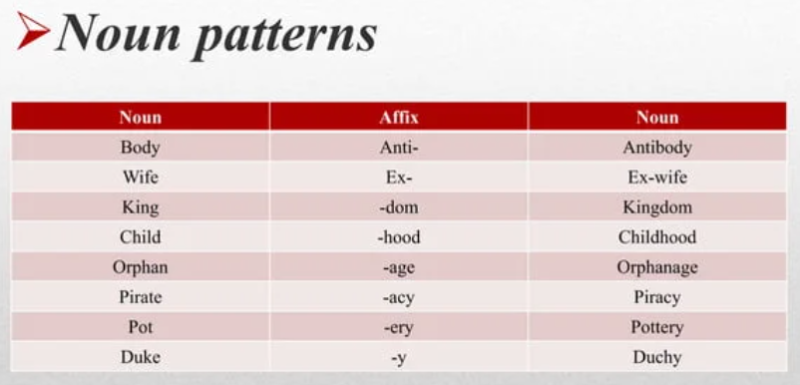
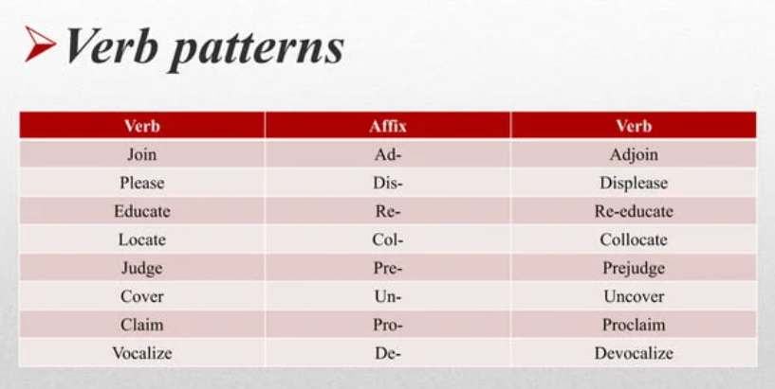
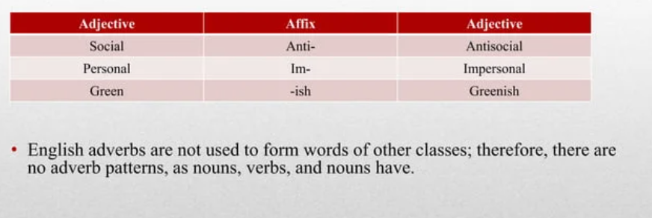
Class-maintaining affixes

Slide 21
Identify the affixes within the following words and determine whether each morpheme is free or bound. Additionally, specify whether each affix is inflectional or derivational and provide justification for your classification. (a) irresponsibility (b) reconstruction (c) swimming (d) friendship (e) childishness
Word | Affix | Morpheme Type | Inflectional/Derivational | Justification
Irresponsibility | ir- (prefix) | Bound | Derivational | Changes meaning to opposite (irresponsible)
 | respons (root) | Free | N/A | Cannot stand alone
 | -ibility (suffix) | Bound | Derivational | Changes adjective to noun
Reconstruction | re- (prefix) | Bound | Derivational | Indicates repetition (reconstruct)
 | construct (root) | Free | N/A | Can stand alone
 | -ion (suffix) | Bound | Derivational | Changes verb to noun
Swimming | swim (root) | Free | N/A | Can stand alone
 | -ing (suffix) | Bound | Inflectional | Forms present participle/gerund
Friendship | friend (root) | Free | N/A | Can stand alone
 | -ship (suffix) | Bound | Derivational | Indicates state/condition
Childishness | child (root) | Free | N/A | Can stand alone
 | -ish (suffix) | Bound | Derivational | Changes noun to adjective
 | -ness (suffix) | Bound | Derivational | Changes adjective to noun

Slide 22
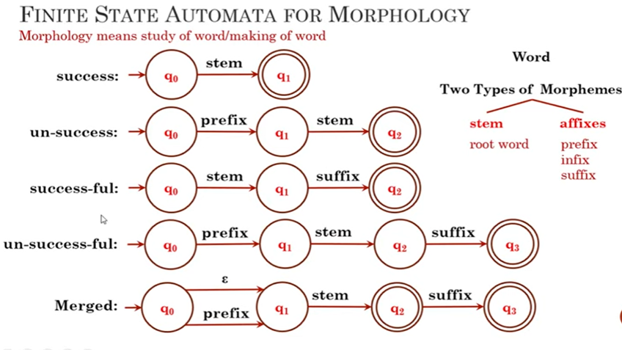
Application of FSA in NLP
Word Recognition
Dictionary Lookup
Spelling Conventions

Slide 23
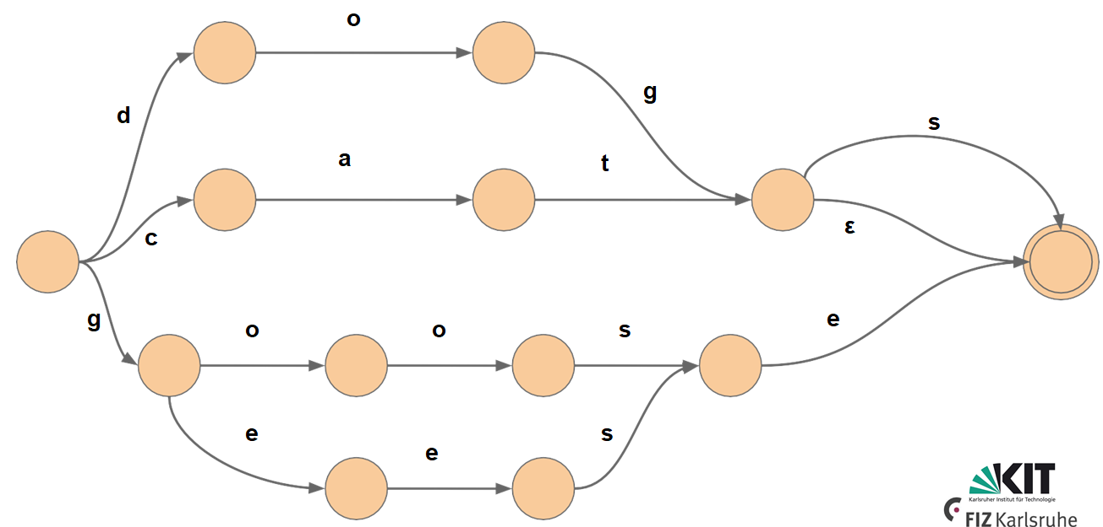
Expanded FSA for few English Nouns
dog
dogs
cat
cats
goose
geese

Slide 24
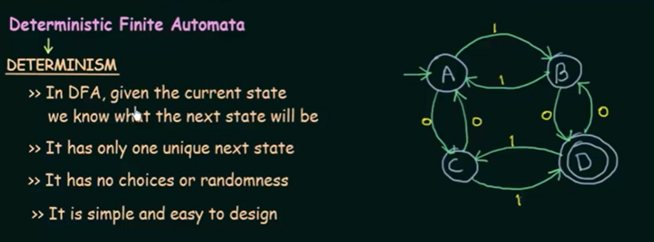
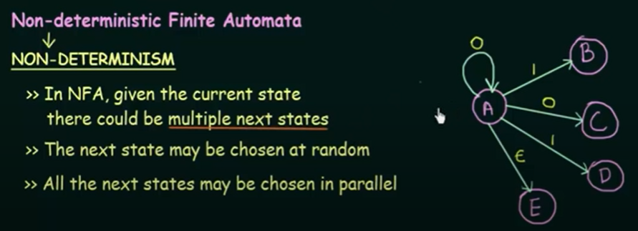

Slide 25
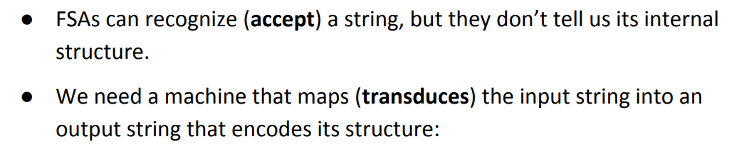
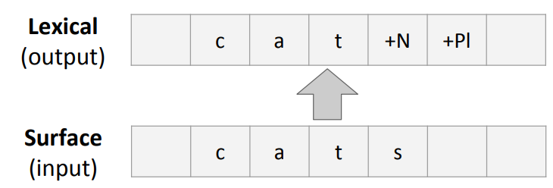
Finite State Transducers

Slide 26
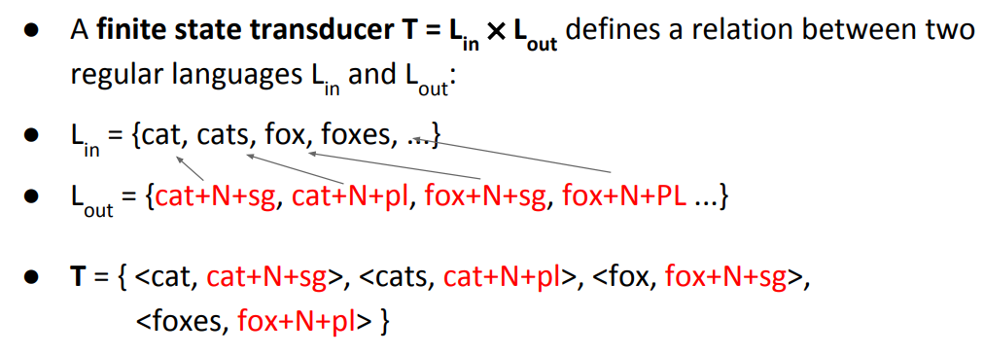
Formal Definition of FST
T defines the relation of the language

Slide 27
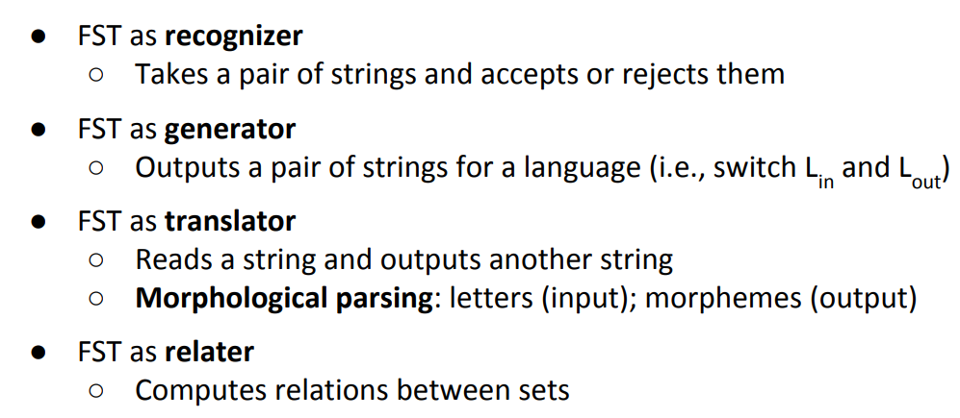
FSTs for NLP

Slide 28
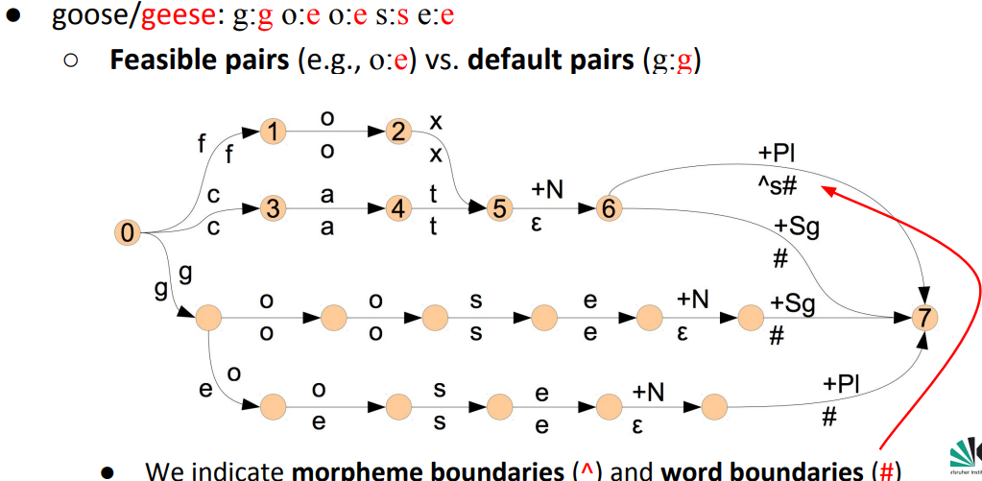
FSTs for Morphological Parsing

Slide 29
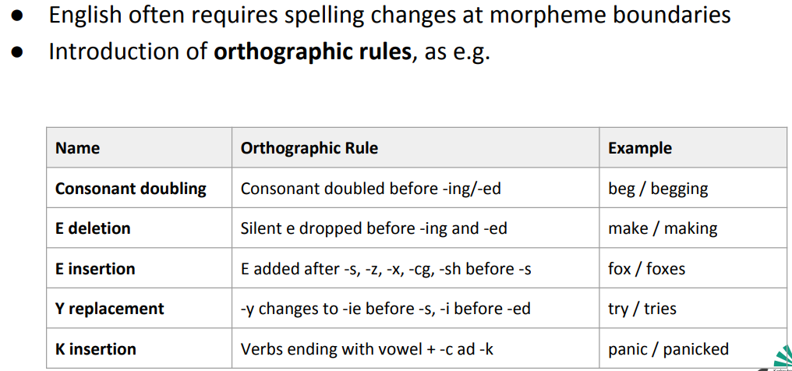
FST’s and Orthographic rules

Slide 30
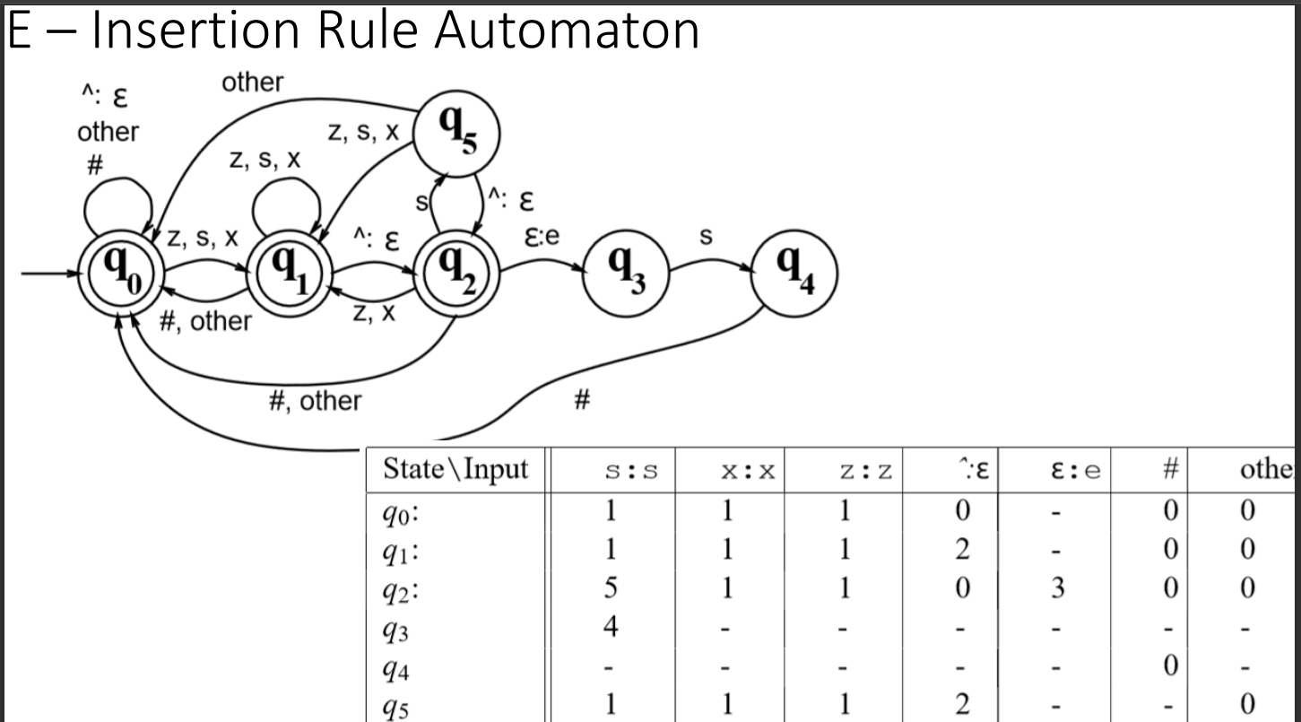

Slide 31
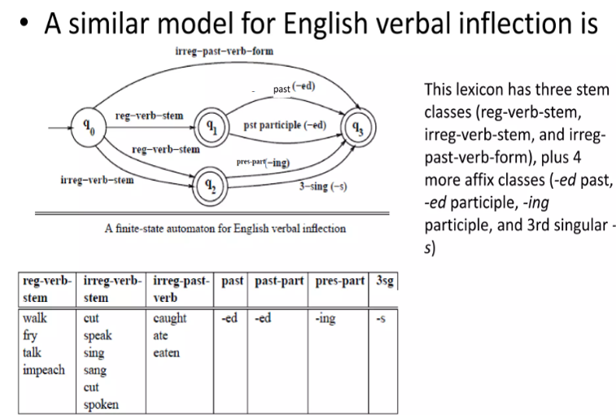

Slide 32
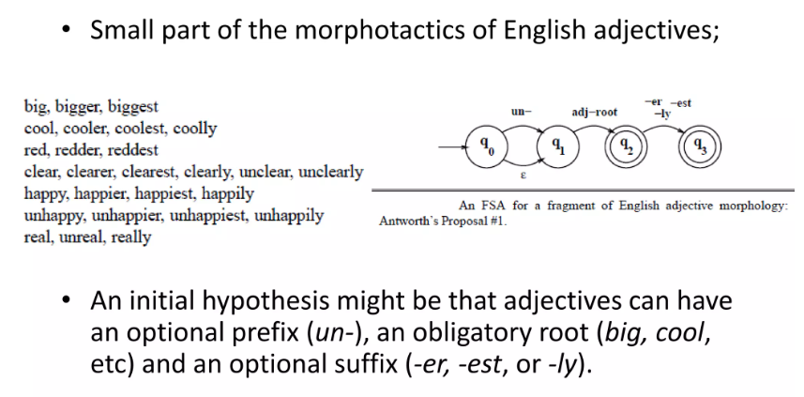

Slide 33
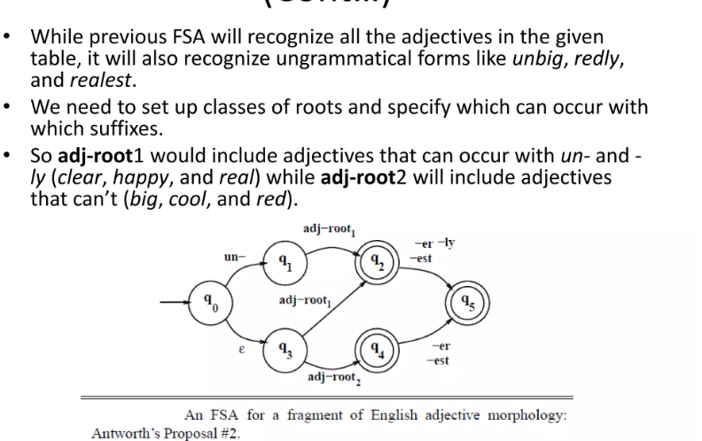

Slide 34
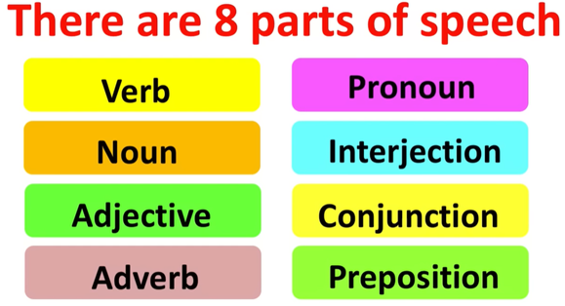
Parts Of Speech(POS)
Types of Phrases
Noun Phrase
Verb Phrase
Prepositional Phrase
Adjective Phrase
Adverb Phrase

Slide 35
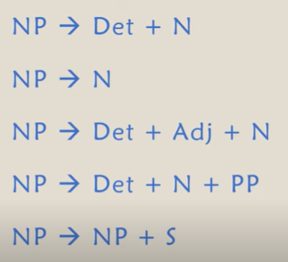
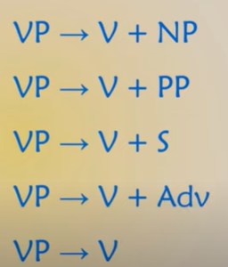
Noun Phrase
Adjective Phrase: AdjP -> Adv + Adj + PP
Eg: quite happy with the result
Adverb Phrase : AdvP - > Deg + Adv
Prepositional Phrase: PP - > Deg + NP
Deg: Degree adverb(optional)
Adj: Adjective
PP : Preposition Phase(optional)
Verb Phrase

Slide 36
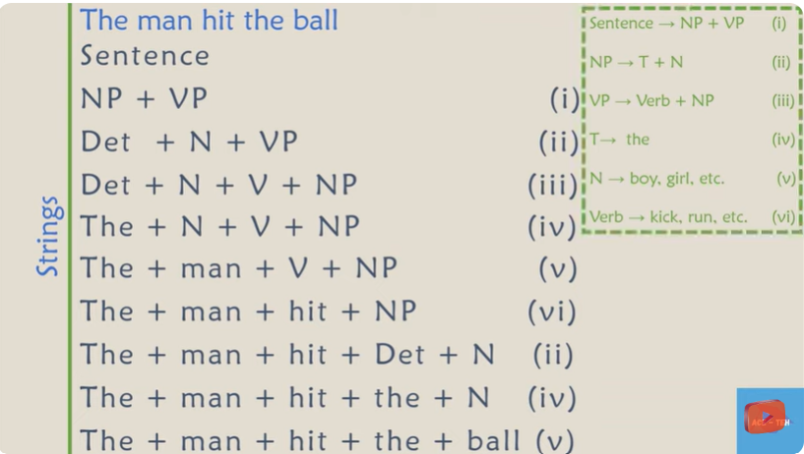
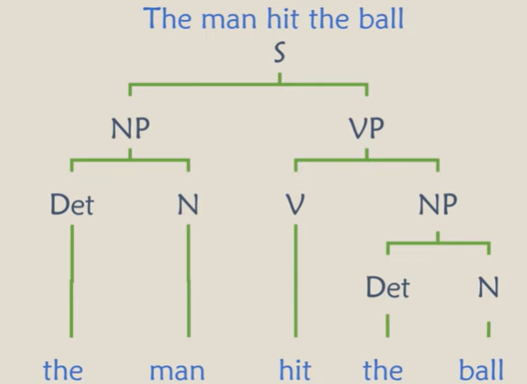


Syntactic structure

Slide 37
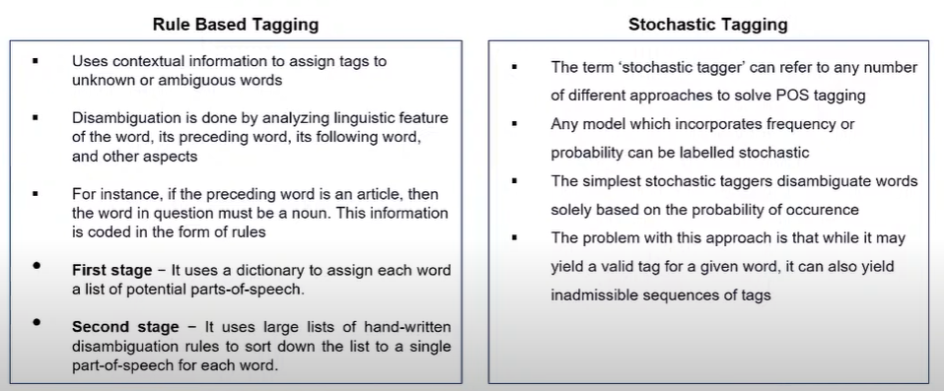
Types of POS tagger

Slide 38
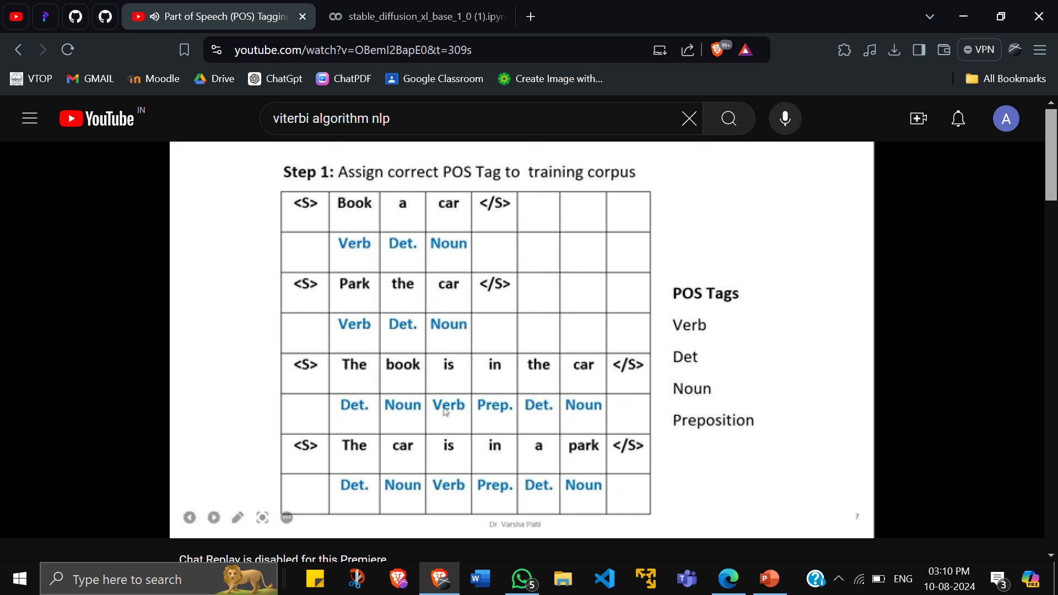
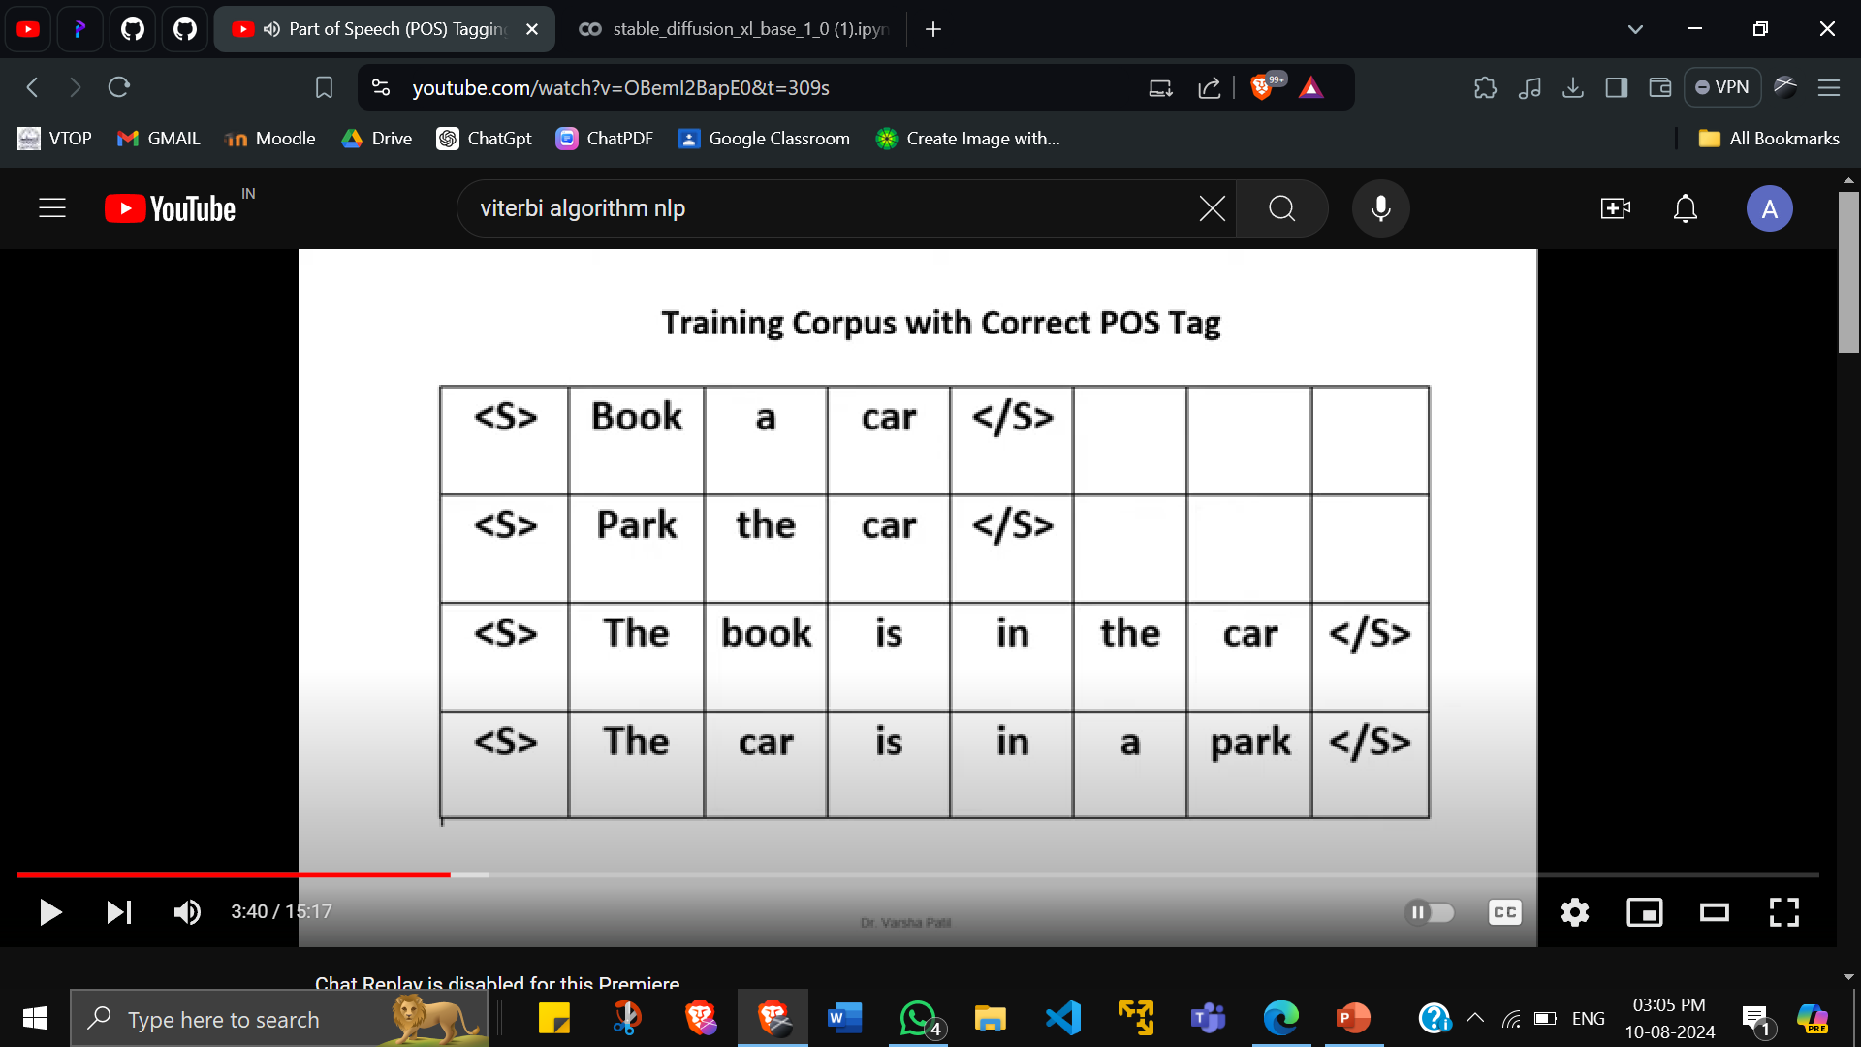
Viterbi Decoding for HMM
https://youtu.be/OBemI2BapE0?si=Axw25s6wNkJtxBiQ

Slide 39
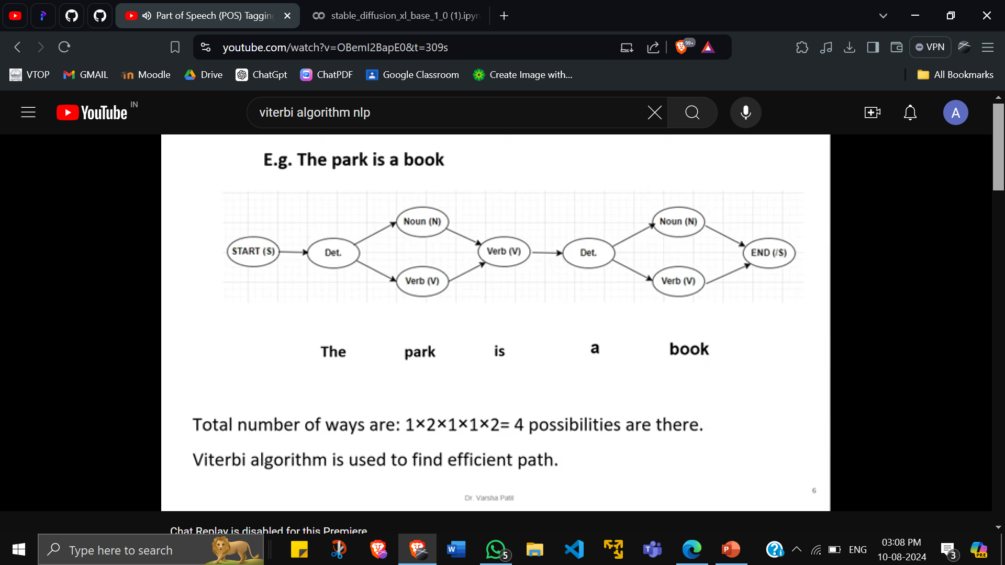

Slide 40
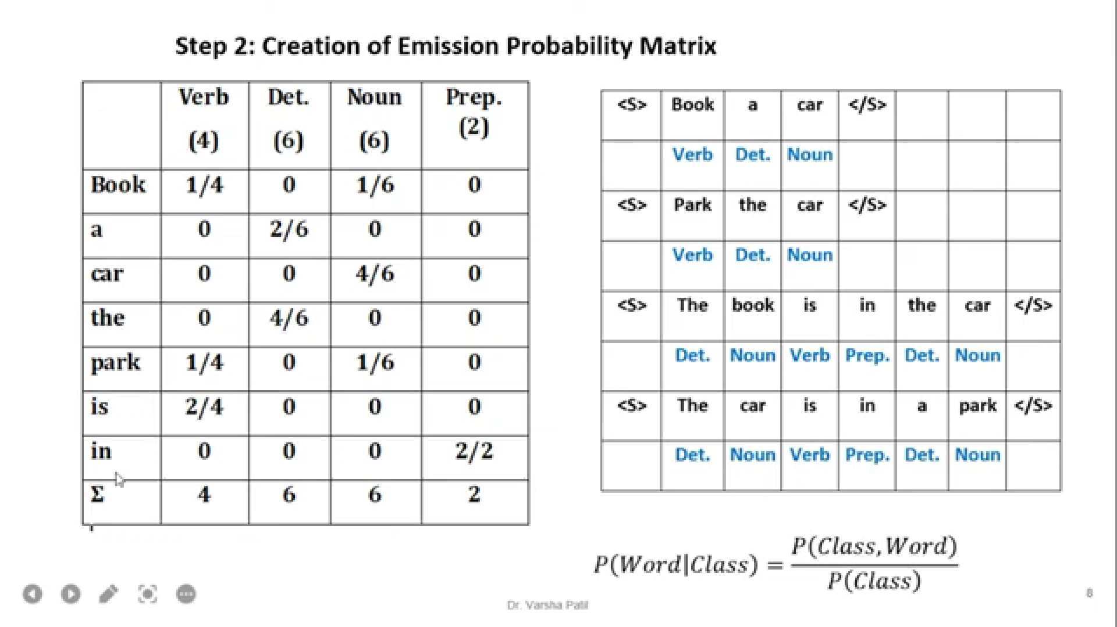

Slide 41
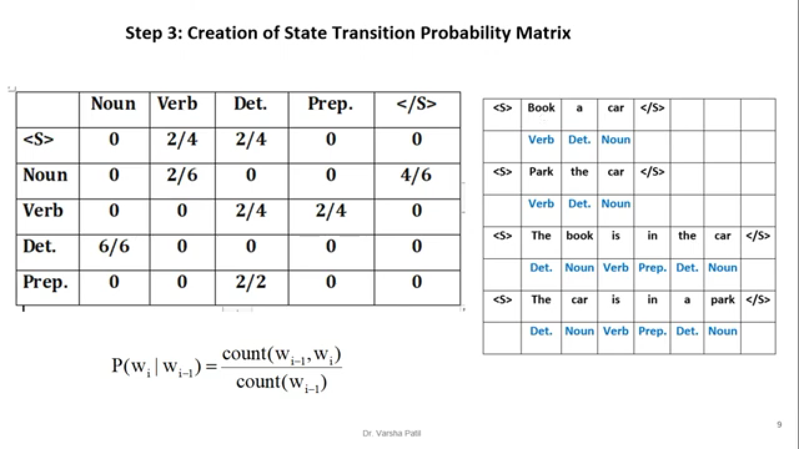

Slide 42


Slide 43

In case ans = 0, smoothing so multiply by 1/100

Slide 44


Slide 45


Slide 46

https://youtu.be/svZ21e4o4S0?si=lpErIKpCalSFoMdr

Slide 47

SOLVED EXAMPLE HMM

Slide 48


Slide 49



Slide 50


Slide 51


Slide 52


Slide 53


Slide 54


Slide 55

https://www.mygreatlearning.com/blog/pos-tagging/
Notes:
https://www.youtube.com/watch?v=hjFbmosY9y4

Slide 56











Slide 57



Slide 58
Application of HMM
Part-of-speech tagging: Using the word order and the POS tags of words around it, HMMs can predict the part-of-speech tag for each word in a sentence.
Named Entity Recognition :Named entities in text, such as names of people, places, or organizations, can be found using HMMs.
HMMs can turn spoken language into text by simulating the probability distribution of speech sounds given the words being spoken.
HMMs can translate text from one language to another by simulating the probability distribution of words in the target language given the words in the source language.
Language modelling: Using the previous words in a sequence as a guide, HMMs can predict the following word. This can enhance the efficiency of language processing tasks like text generation and spelling checking.

